Slide 1
​ ​ MIDTERM PROJECT-FIRE DEPARTMENT NEW YORK​
Tejalakshmi Gangadhar Chalumuri
Daniel Nehemiah Peter Katam
Sai Sujith Reddy Jupalli
Daivikh Rajesh Mysuru
Harshil Ashish Desai

Slide 2
Goal:
Find which Borough is having highest number of fire accidents
What are the major reasons behind these accidents
What has been the best solution to reduce the Fire

Slide 3
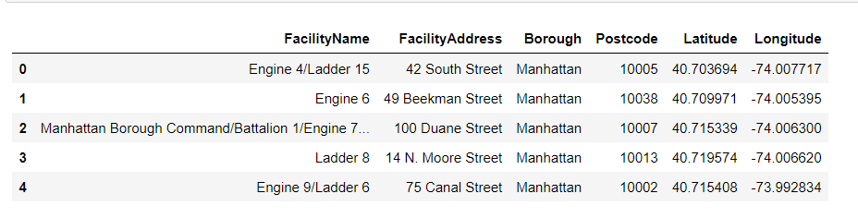
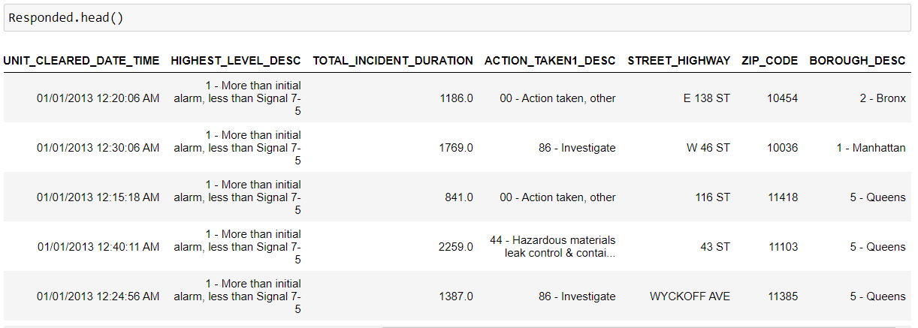
Data Source and Loading
We have taken 3 Datasets related Fire Accidents from NYC Open Data
1st Dataset: FDNY_Firehouse_Listing - This dataset gives the locations of the firehouses
2nd Dataset: Incidents_Responded_to_by_Fire_Companies - This dataset gives the Amount of time take and technique used to reduce the fire by companies on different situations.

Slide 4
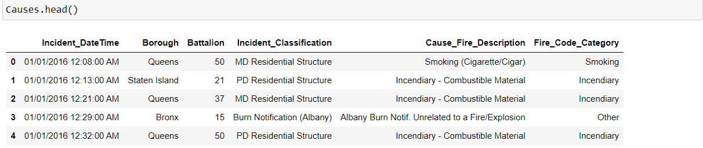
3rd Dataset: Bureau_of_Fire_Investigations_-_Fire Causes - This dataset gives us the reasons behind the start of the Fire​

Slide 5
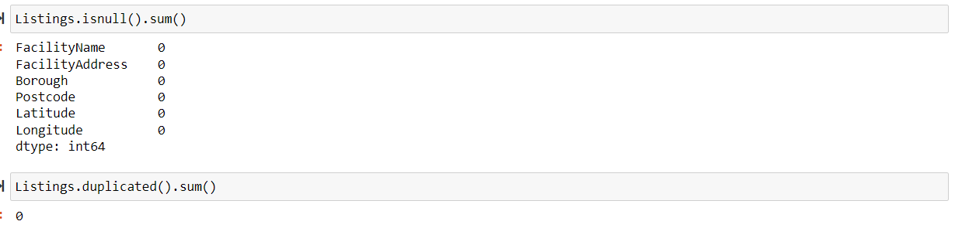
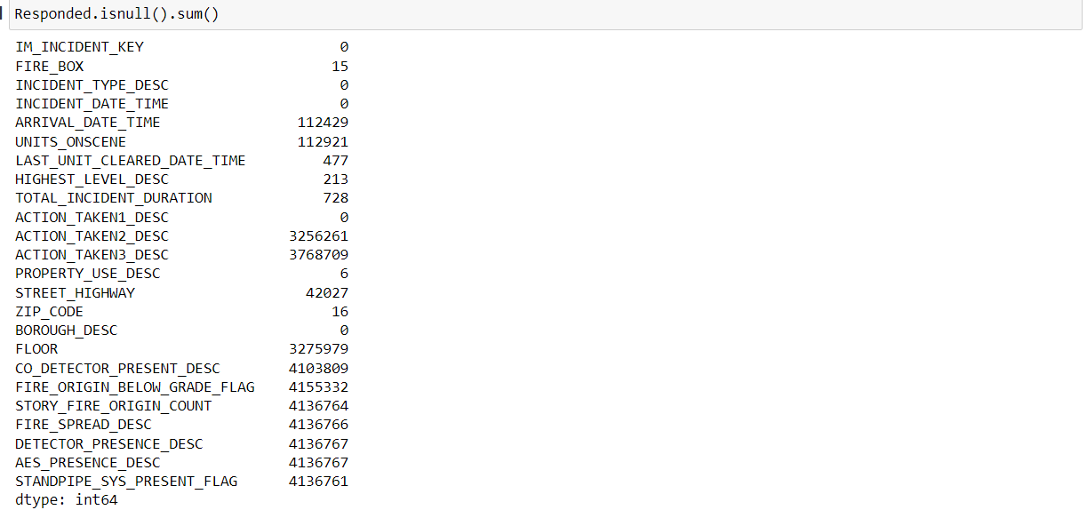
Cleaning and preprocessing the data
First we have checked for null values then the duplicate values
Listing dataset had no null values or duplicate values, it is good for further analysis
Responded dataset had many missing values. We had to remove few columns since more than 75% data was missing and imputing them might not be the best way to handle. We also had to remove few rows and the duplicate values which gave us a cleaned dataset for analysis

Slide 6
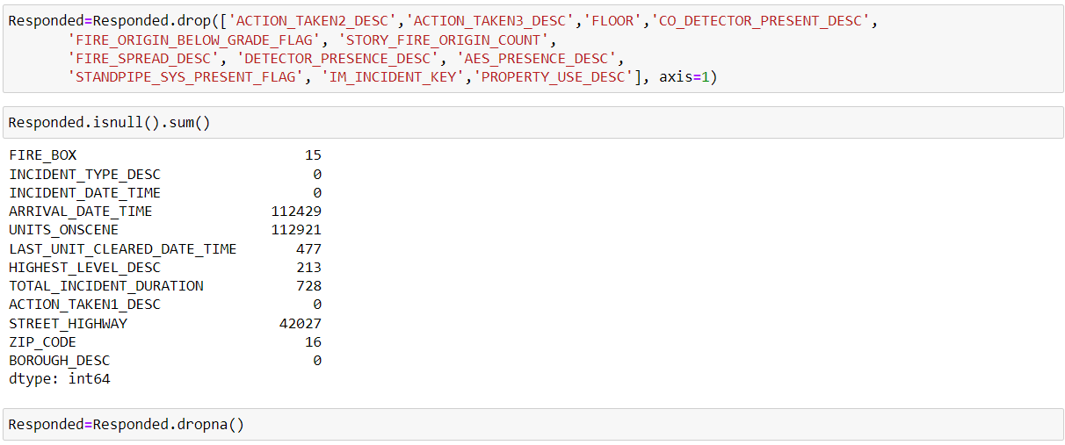
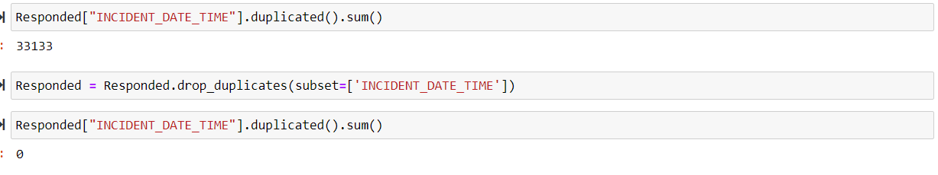
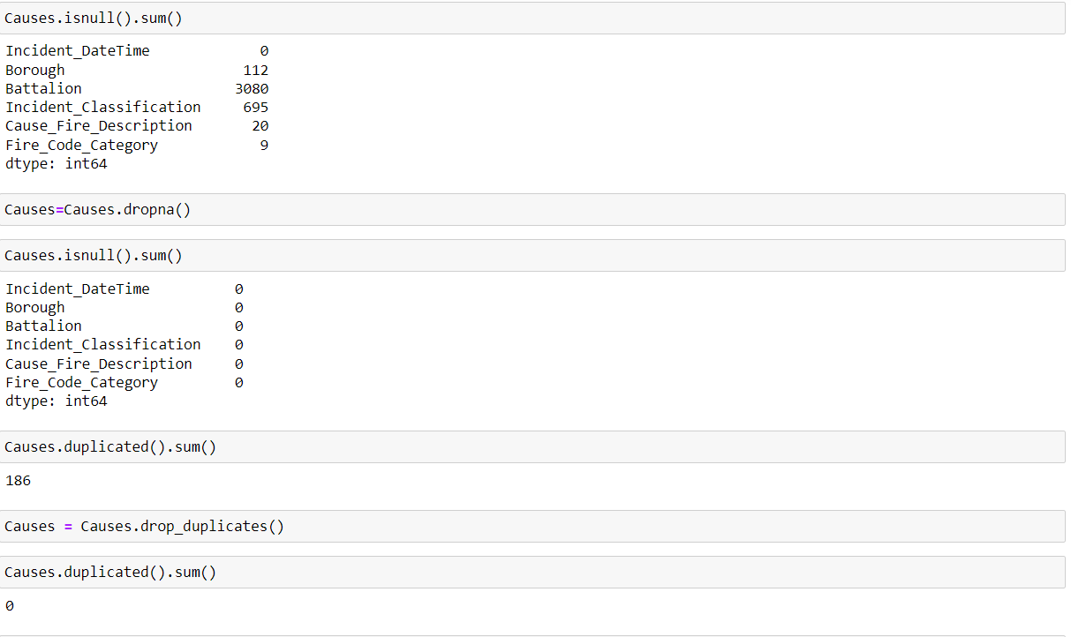
In causes dataset there were only fewer null values so removing the rows was good and we had no duplicate values which need to be treated
We then saved all three cleaned datasets and Exported to Pg-Admin queries

Slide 7
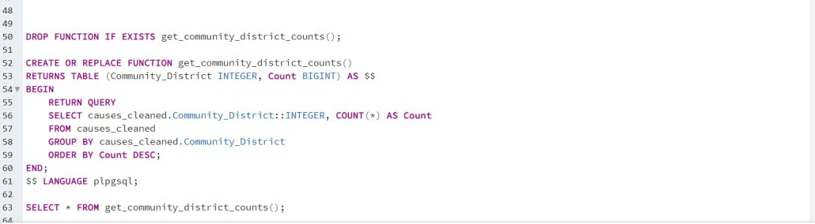
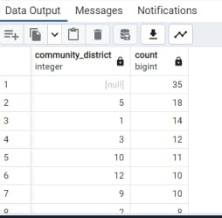
SQL queries
We have loaded all three datasets into the database
Primary key and foreign key for the datasets were Incident Date time- which is the time and the year when the incident has happened
This query gives us the top 10 community district having more fire accidents

Slide 8
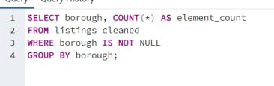
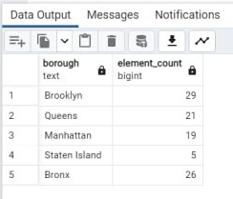
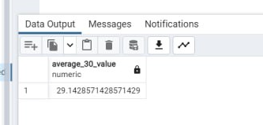
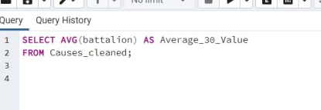
Above query returned the count of fire accidents on the bases of borough And we could see Brooklyn had the highest number of fire accidents
This query returned the average number of battalion people attended to resolve the fire accident having

Slide 9
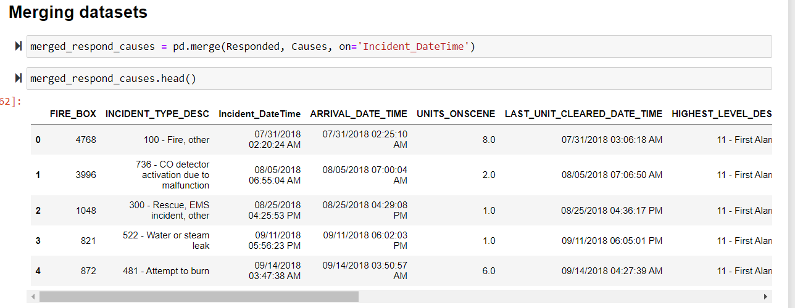
Data Analysis & Visualization:
Firstly we have merged the datasets on the bases of Incident Date time and created a new dataset as merged_respond_causes
We then created new columns such as Date and Time using Timestamp method on column Incident_Date_Time

Slide 10
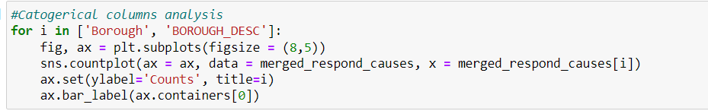
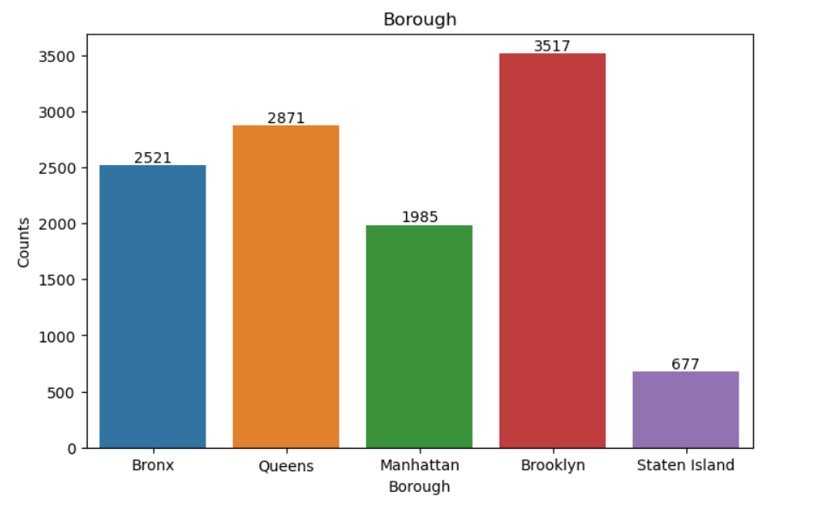
From the above chart we can say that Brookly has the highest number of fire accident and then comes Queens, Bronx , Manhattan and lastly Staten Island.

Slide 11
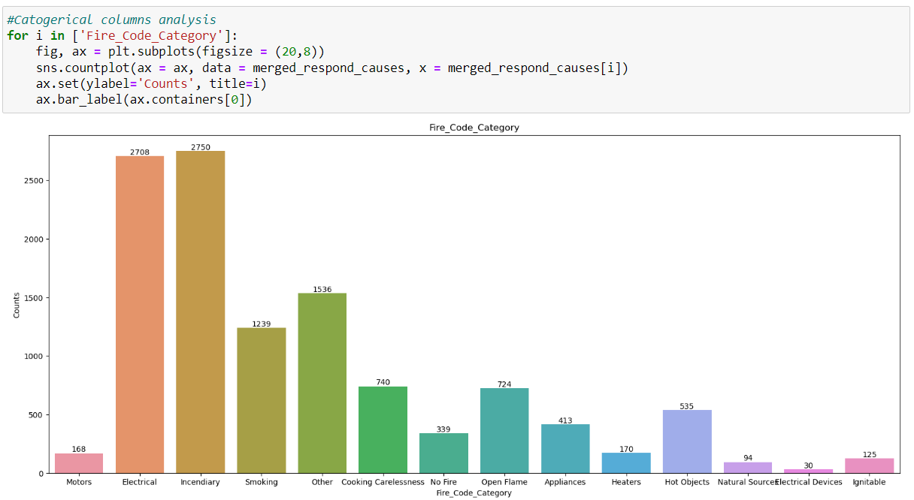
In the above chart we can see that Incendiary (Devices) and Electrical issues are the main reasons for the cause of fire accidents.

Slide 12
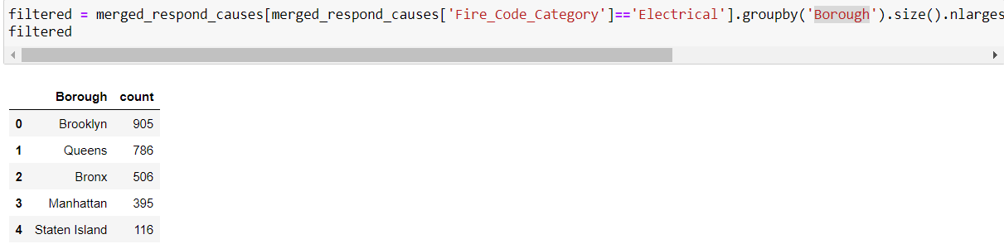
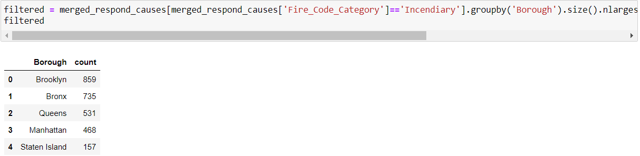
We checked for highest count of electrical accidents based on Borough using groupby function and we can see that Brooklyn is having the highest number of electrical accidents
We have also checked for highest count of Incendiary accidents based on Borough using group by function and we can see that Brooklyn is having the highest number of Incendiary accidents​ then Bronx and Queens.

Slide 13
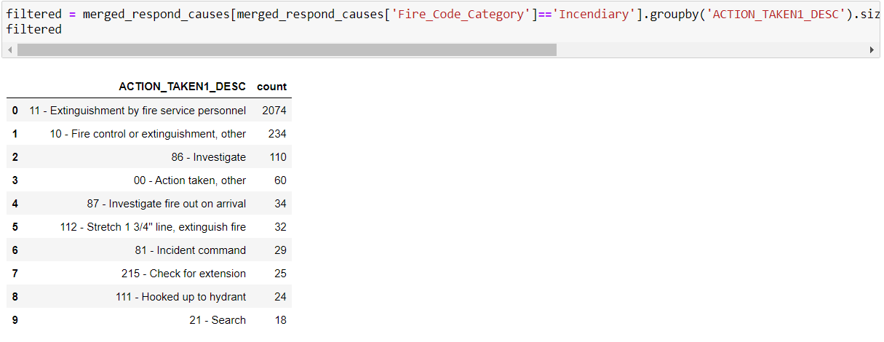
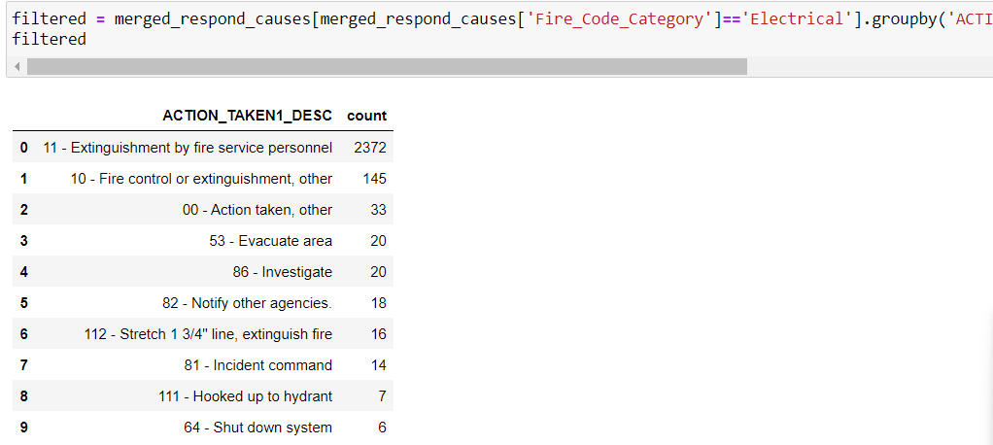
We can see that no matter the reason behind the fire accident to occur the best possible way is Extinguishment by fire service personnel then Fire Extingusgment

Slide 14
Challenges:
Being very large dataset there were many null and duplicate values which were to be treated
Again Being a large dataset Inconsistent in the dataset had to be treated
Merging the dataset had few challenges which need to be adjusted without disturbing the data
Solutions:
We saw that Brooklyn Borough had the highest number of fire accidents, Queens , Bornx, Manhattan and lastly Staten Island.
Incendiary(Devices) and Electricity are the major reasons for a fire accident to occur
Most of the time issue was resolved by Extinguishment by fire service personnel

Slide 15
Future Steps:
Alerts and Notifications:
Implement a system to send automated alerts or notifications when certain predefined conditions are met (e.g., sudden increase in a specific type of incident).
Use email, SMS, or other communication channels for alerting concerned parties.
Geospatial Analysis:
Use geospatial data to analyse the distribution of incidents on a map.
Implement automation to update and visualize the geographic patterns of incidents.
Security and Access Control:
Implement automated security checks to ensure the confidentiality and integrity of the data.
Set up access controls to restrict data access based on user roles and responsibilities.

